Slide 1
Customer Churn Analysis
Presented by: Rachael nyawira

Slide 2
Introduction
Customer churn refers to the phenomenon where customers stop using a company’s products or services. This analysis aims to understand the factors influencing churn using data visualization and a predictive decision tree model. The goal is to help stakeholders make informed decisions to reduce churn and improve customer retention.

Slide 3
Data Overview
We used a dataset containing information on 3,333 customers. Each row represents one customer and includes details such as:
- Call minutes and charges (day, evening, night, international)
- Use of international plan and voice mail plan
- Number of customer service calls
- Whether the customer churned or not (target variable)

Slide 4
Key Metrics(KPIs)
The key performance indicators (KPIs) highlighted on the dashboard include:
- Total number of customers: 3,333
- Average total day minutes: 179.8
- Churn rate: Approximately 14.9%

Slide 5
Visual Analysis
Several visualizations were used to better understand the data:
- Bar chart of churn by international plan
- Relationship between customer service calls and churn
- Total day charges vs churn
- Overall churn distribution
These insights help identify patterns and possible causes of customer churn.

Slide 6
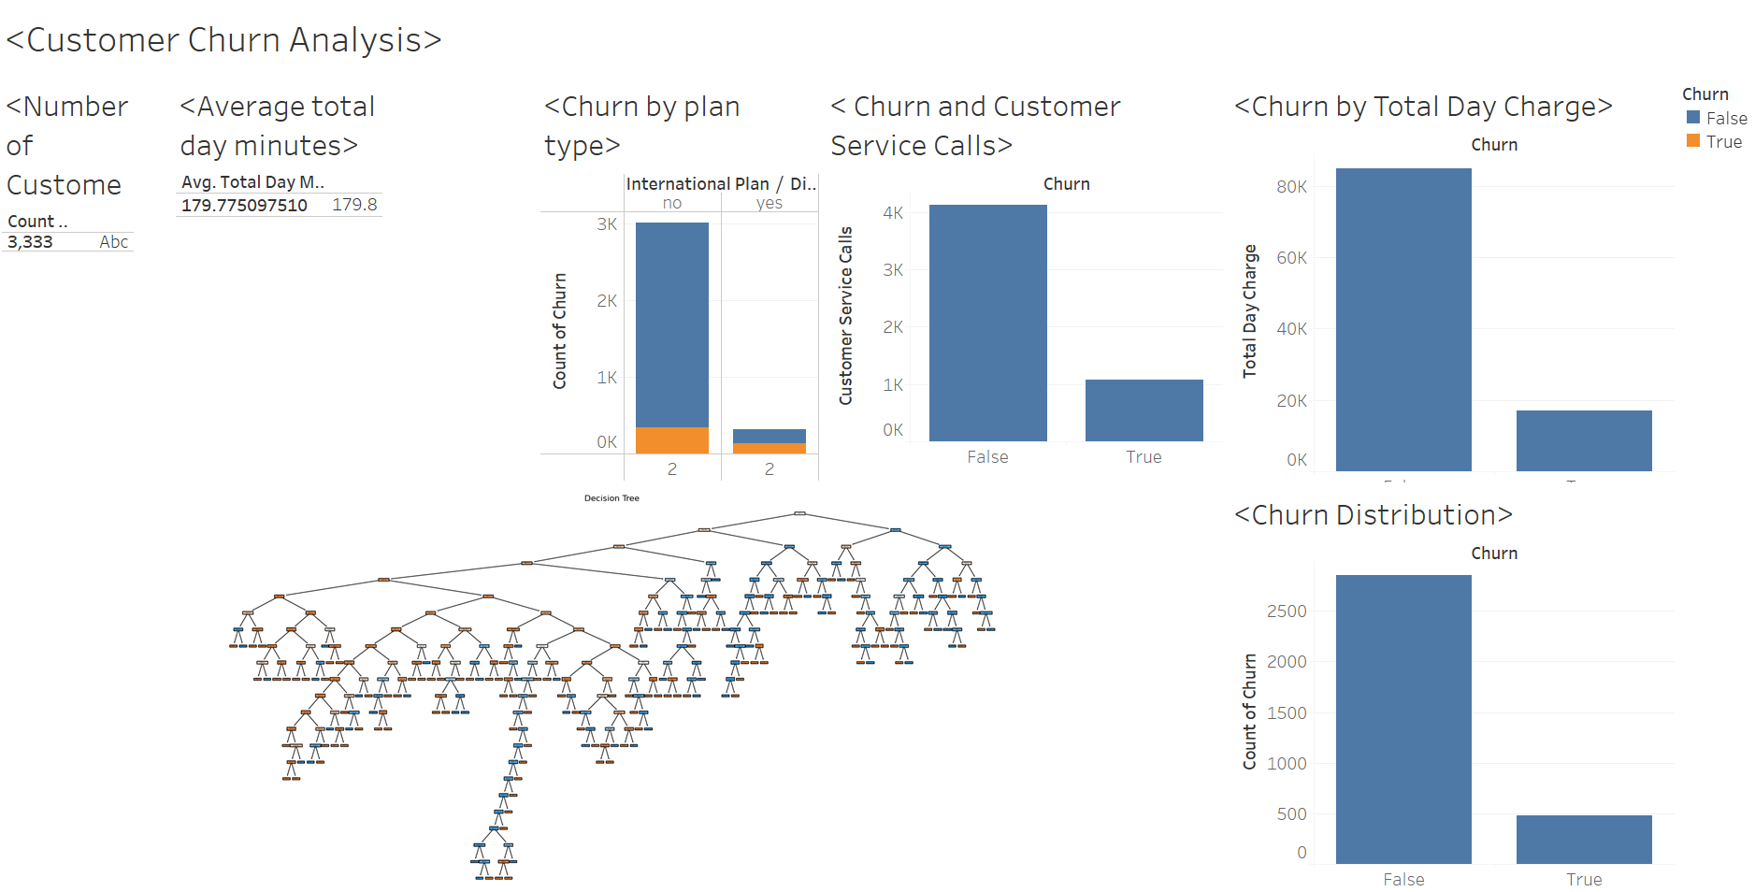
Visual Presentation

Slide 7
Predictive Modeling Approach
I built a decision tree classifier to predict whether a customer is likely to churn. The decision tree is easy to interpret and highlights which features contribute most to churn, such as:
- Number of customer service calls
- International plan usage
- Total day minutes and charges

Slide 8
Decision Tree Summary
The decision tree model successfully captures customer behavior patterns. Key decision points in the tree indicate that customers with many service calls or who use the international plan are more likely to churn.
This model helps segment customers into high and low churn risk groups.

Slide 9
Insights and Recommendations
Customers using the international plan have a higher likelihood of churn.
Frequent customer service calls correlate strongly with churn, possibly indicating dissatisfaction.
Targeted support and offers to high-risk customers can reduce churn.
Monitor key features such as service usage and complaints regularly.

Slide 10
Conclusion
This analysis provides a comprehensive understanding of churn using data visualization and predictive modeling. The decision tree model serves as a valuable tool for customer retention strategies, offering actionable insights in a clear, non-technical format.

